Slide 1
Realtà e prospettive della collaborazione Italia Israele Aprile 2017
Ufficio Commerciale
Ambasciata d’Israele, Milano

Slide 2
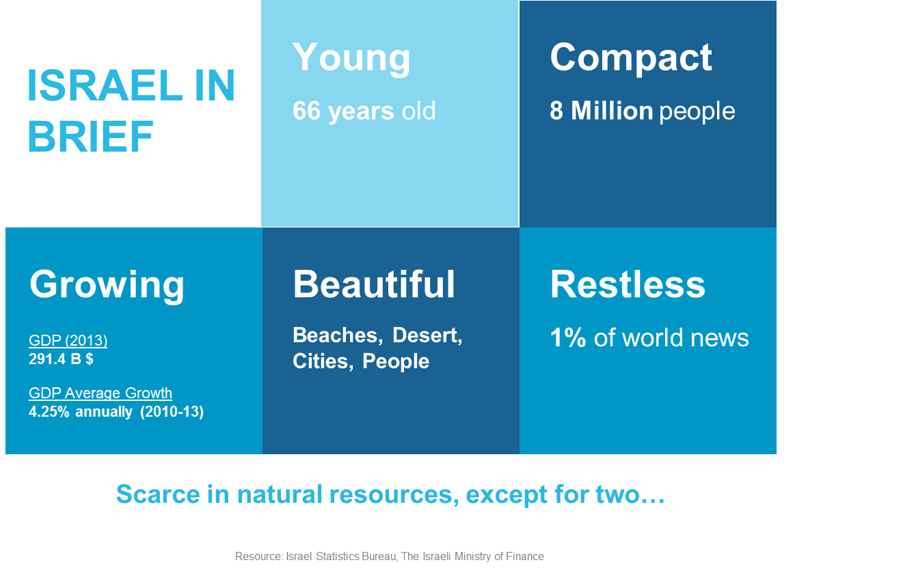
Short Introduction

Slide 3
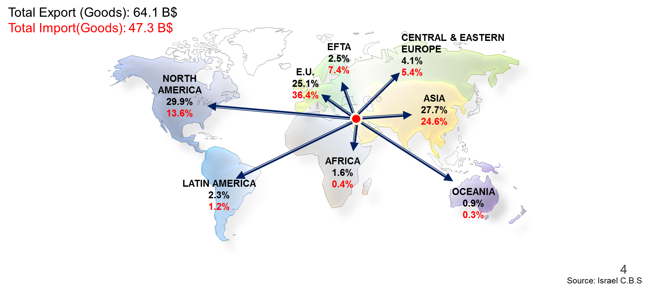
Israel’s Exports and Imports of Goods, 2015

Slide 4
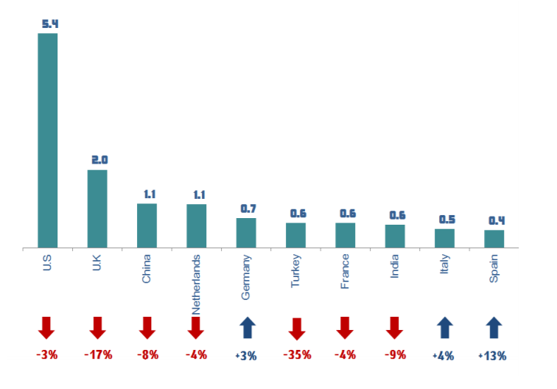
Israel's 10 leading export destinations in h1.2016

Slide 5
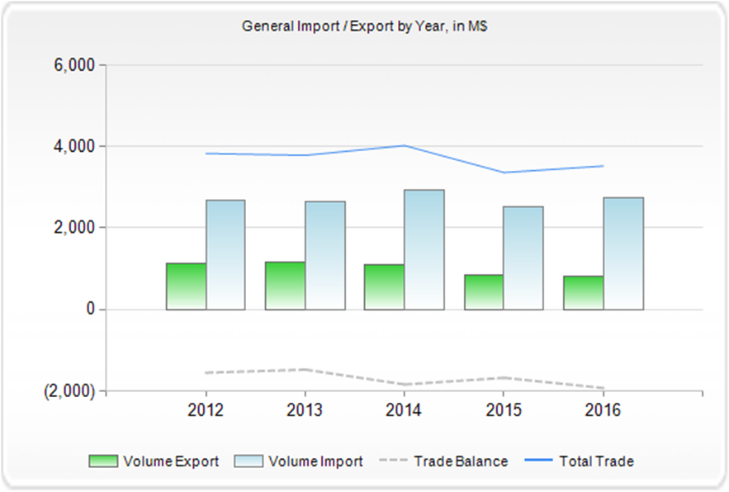
Israel-Italy Trade 2012-2016

Slide 6
MULTI SECTOR INNOVATION
Strong clusters of novelty and innovation across a broad range of industrial sectors
Health Industry
Telecom
Internet &
New Media
Water Technologies
Agriculture & Food
HLS & Aerospace
Industrial Technology
IT & Enterprise
Renewable Energies
Notes:
Remove the watermark from Getty images here
Industrial Technology has a hanging y. I made the font smaller so it would fit on one line
New Media

Slide 7
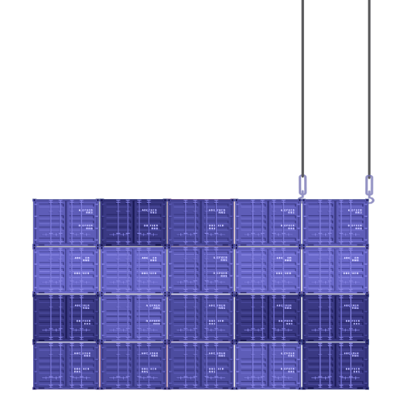
Hi Tech Sector - Huge Impact on the Israeli Economy
10% of employees
15% of GDP
50% of Industrial Exports
In 2015- 2500 Startups, 178 VCs and Private Equity, 3000 SMEs, 146 Innovation hubs (61 Accelerators, 34 incubators, 35 Entrepreneurs programs)
Hi-Tech sector in Israel : 270K employees
In 2015 the Israeli startups raised 4.4 billion $ and had exits in total amount of 8 billion $.
Cyber is the hottest sector with exits amounted in 1.3 billion $. 350 cyber companies.

Slide 8
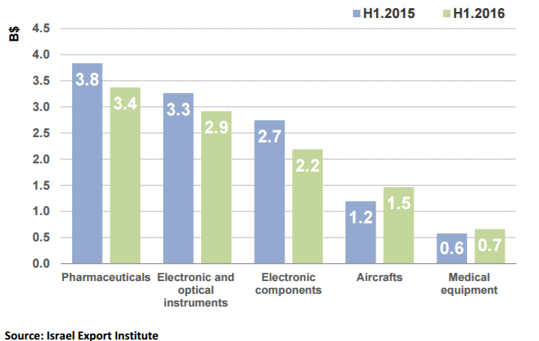
Exports of high-tech by sector H1.2016 versus H1.2015, (original data, $ billion)

Slide 9
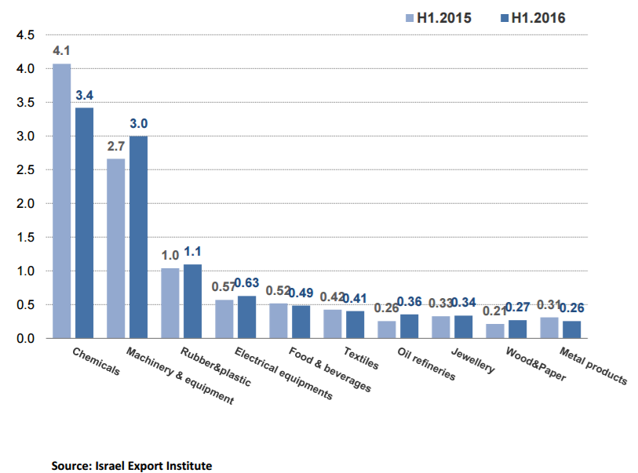
Industrial exports, Exc. High-Tech H1.2016 versus H1.2015, (original data, $ billion)

Slide 10
R&D funding: Exhisting tools
Bilateral program for R&D Italy Israel (ANNUAL call )
#1 worldwide bilateral program in number of project
European Programs: Israel full partner of H2020,
Israel in European R&D program since FP5

Slide 11
Bilateral R&D Program Characteristics
Industrial R&D in all sectors
Annual Calls for Proposals
Joint Participation and contribution of both sides to the project
Project Financing up to 50% of Costs
Funding Agencies
In Italy – Ministry of Foreign Affairs
In Israel - IIA-Israel Innovation Authority
Mr.Ran Arad
E-mail: ran@iserd.org.il

Slide 12
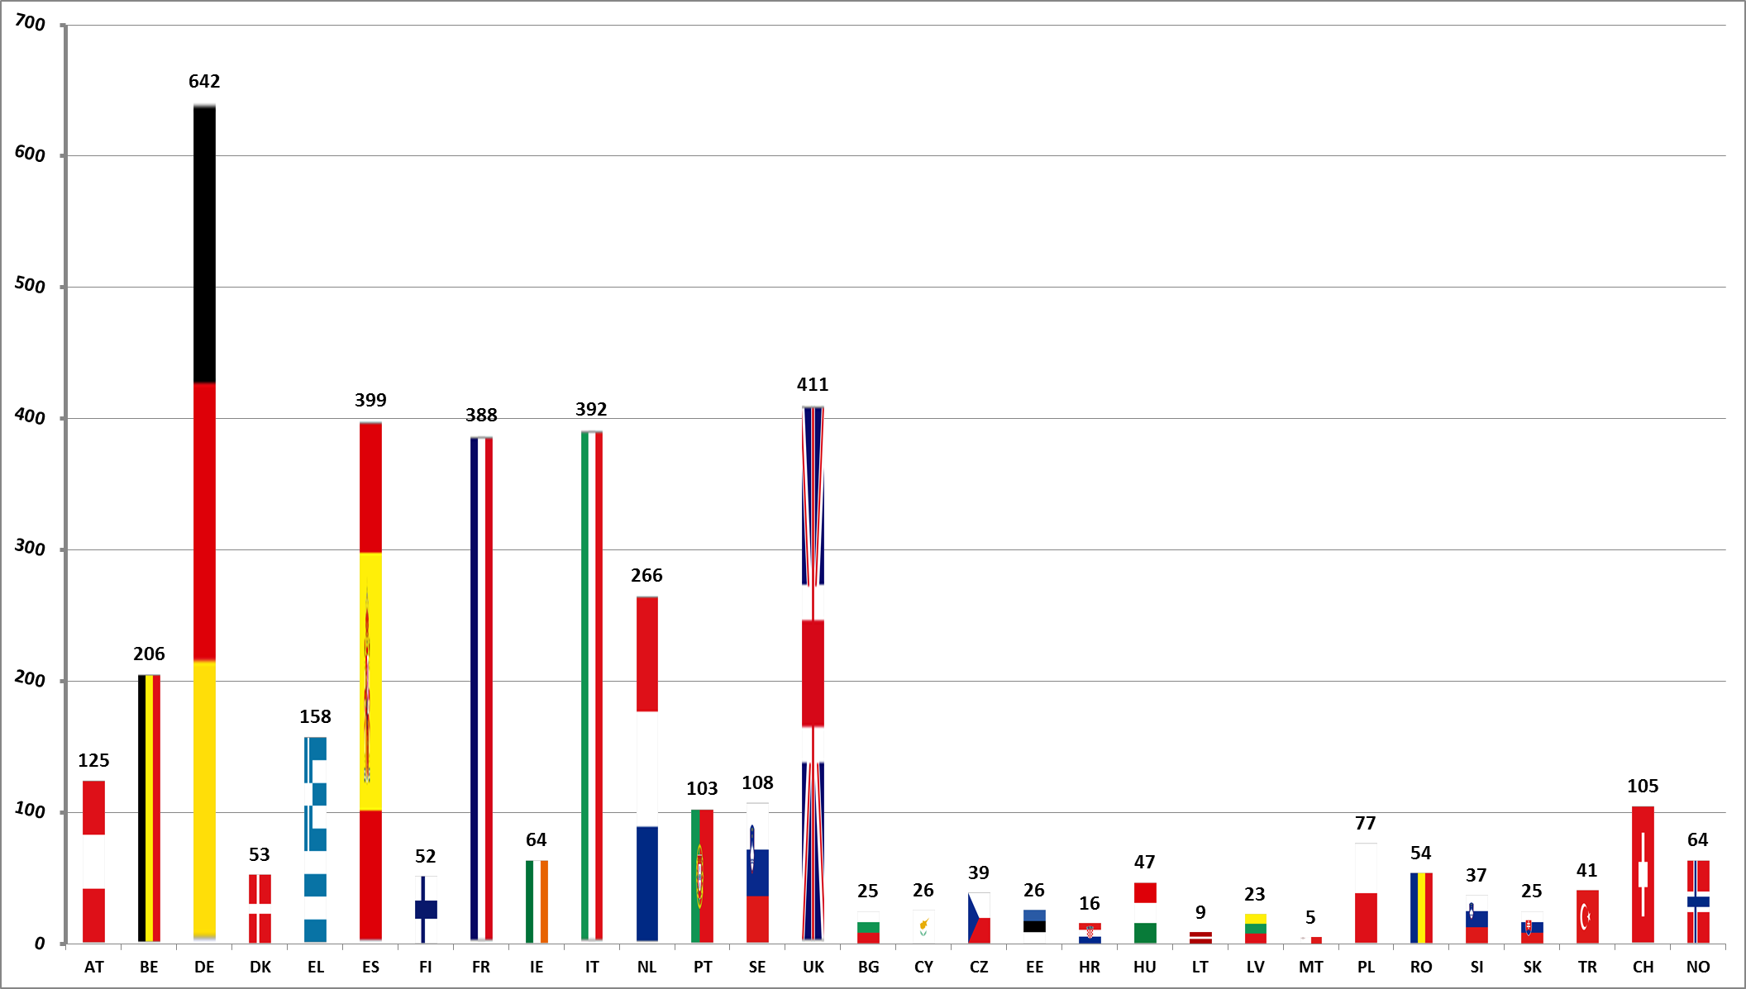
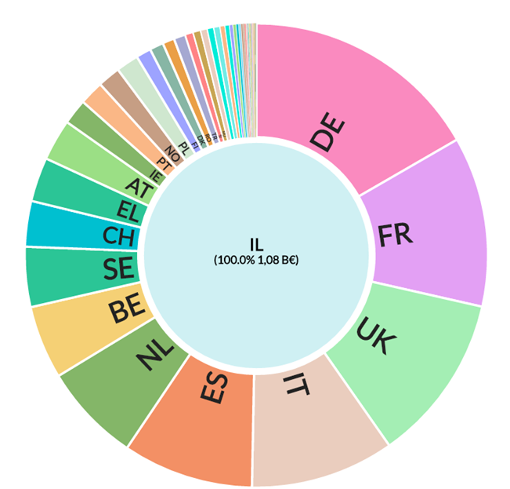
Israel Cooperation in Approved H2020 Projects With EU and Third Partner Countries
projects
Source: E-Corda-Up date 01.11.2016
countries

Slide 13
4 Inspiring examples
FCA – cooperation with the Fuel Choice Initiative and Dor Chemicals for the developments of natural gas based technologies for transportation. Under this project, FCA together with Israeli companies and the support of the Israeli government, developed the first Euro 6 compliant vehicle running on M15, a natural gas based fuel, composed of 85% Gasoline and 15% Methanol. The first Fiat500 was launched on November at the Fuel choice Initiative Summit. LINK
Medical Devices - Rehabilitation and telemedicine- Villa Beretta near lago di Como is assessing some different solutions of telemedicine developed by Early Sense, re-ability and Brain-mark to be implemented on patients needing rehabilitation care and to follow their program of rehabilitation from home or to allow them better care in the hospitals.
Fintech – in the last couple of years, our office is very much involved with introducing new technologies from Israel to Italian banks. After our last Road Show of Fintech leading Israeli companies to Italian banks, some of them adopted Israeli solutions allowing them to improve their digital abilities, allow their clients to use their mobiles for bank operations more freely and by that to be more competitive.
Wastewater treatment – Israeli solutions for reduction of nitrates in the wastewater of dairy farms are used in Lombardy farms. Those solutions prevent the farmers from moving the sludge to a treatment facility. By using those solutions the farmers are able to comply with European Regulation for emissions to soil and groundwater while improving the efficiency of production, reducing costs and energy consumptions.

Slide 14
About us
Division of the Ministry of Economy located in Milano, part of the Embassy in Rome
Work actively on increasing bilateral trade between Israel and Italy
focusing on Israeli exports, that will mutually benefit both countries
Provide individualized services to Israeli exporters
Support joint Research & Development projects
Attract Foreign Direct Investment in Israel
Manage and promote Israeli national pavilions at major trade events
Focal point for Information on the Israeli Industry and Economy

Slide 15
Our main sectors in 2017
Fintech
Cyber security
Automotive
Medical devices + Dental
FoodTech
Water Technologies

Slide 16
Exhibitions and conferences
Future Sport
MWC Barcelona
Med in Israel
Biomed
Ecomotion
Watech Israel
Milipol Paris
Mobile Innovation
Bank Innovation
Medica
IDS
HLS & Cyber
Fuel Choice Conference

Slide 17
Our Team
Giovanna Bossi – Life Science: Medical Devices, Biotech, Dental..
Marco Macchi – Automotive, HLS, AeroSpace, Cyber Security
Michela Vitulano – ICT, Mobile, IOT, New Media
Paola Pagnotta – Cleantech, Water Technologies, Consumer Products
Natalie Gutman-Chen – Head of Economic and Commercial Office in Milano

Slide 18
Find us Online
WWW.Israeltrade.it

Slide 20
https://www.youtube.com/watch?v=SQVDsJYDKZc (Invest in israel) https://www.youtube.com/watch?v=i3wmT2wH690 (MOFA)

