Slide 1


Startup Village
Yokneam
An Alternative High-Tech Ecosystem for Startups
www.StartupVillageYokneam.org

Slide 2
World Class Startup Ecosystem
150 different R&D companies
$6 billion USD (€5.5 billion) annual exports
Gateway – Not a City
Human Capital • Academics • Financial

Slide 3
Main Characteristics
Yokneam is a Gateway – for Human Capital
Expandable – Technology Stays and Grows
Funding is External, but Accessible
Leadership Cuts Bureaucracy

Slide 4
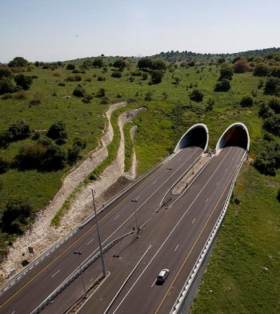
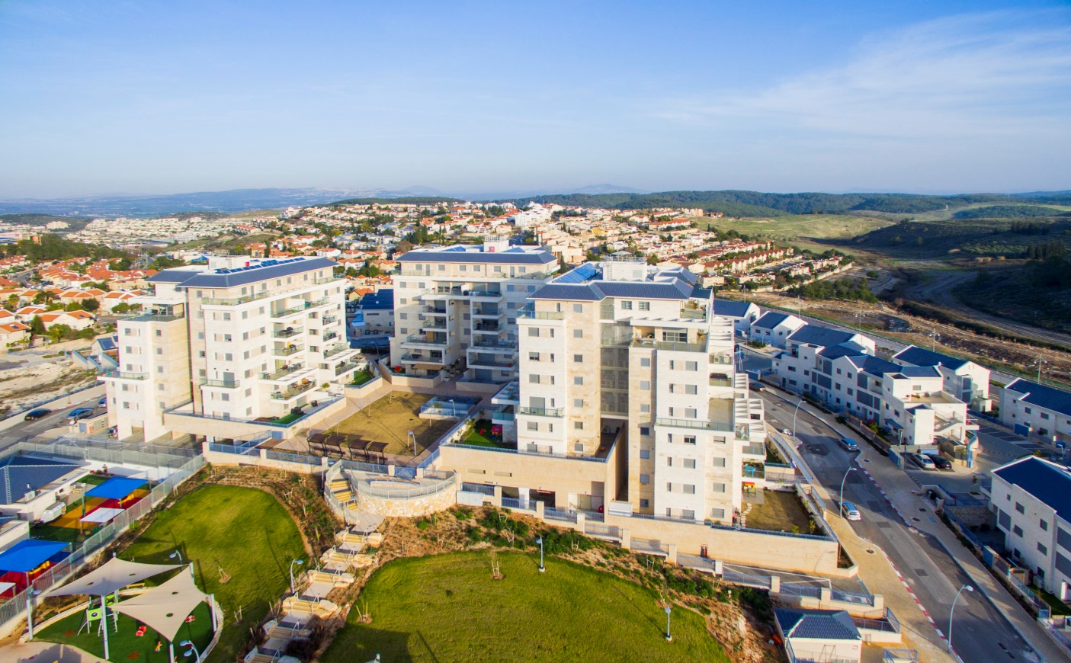
Yokneam is a Gateway
Route 6
Free-flow commute opposite rush-hour traffic

Slide 5

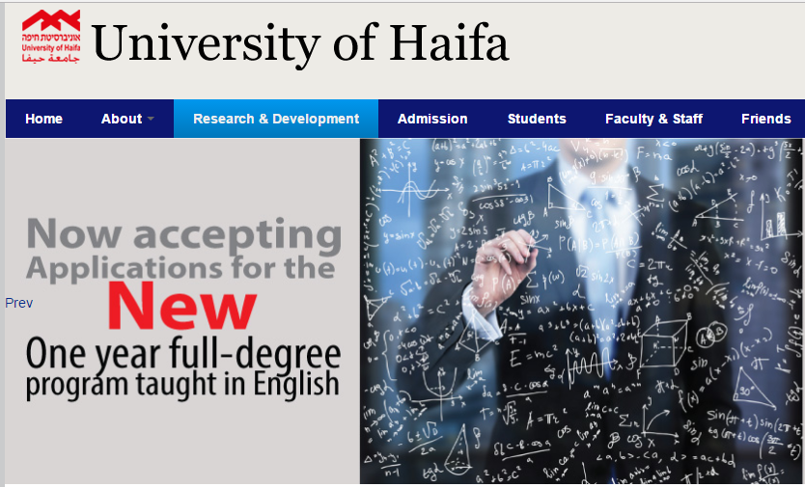
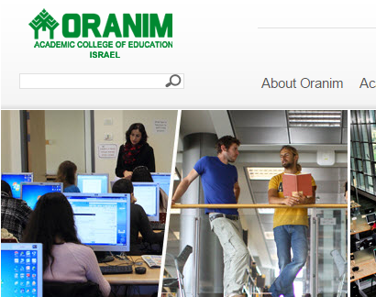
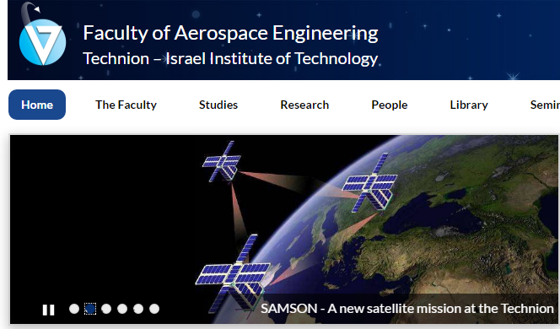
Yokneam is a Gateway
Academic institutions in a 20 minute radius

Slide 6
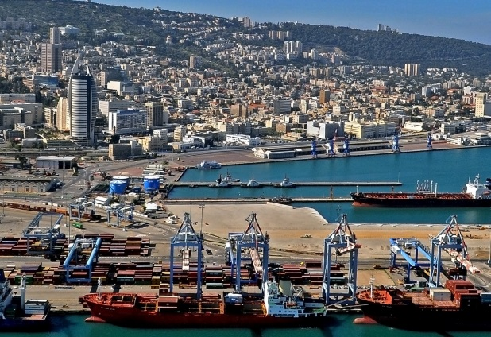
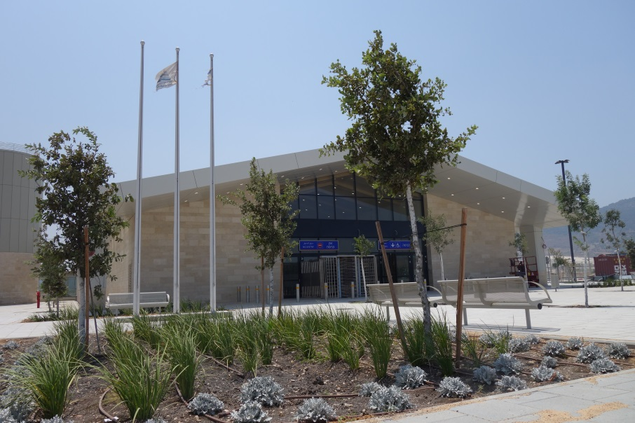
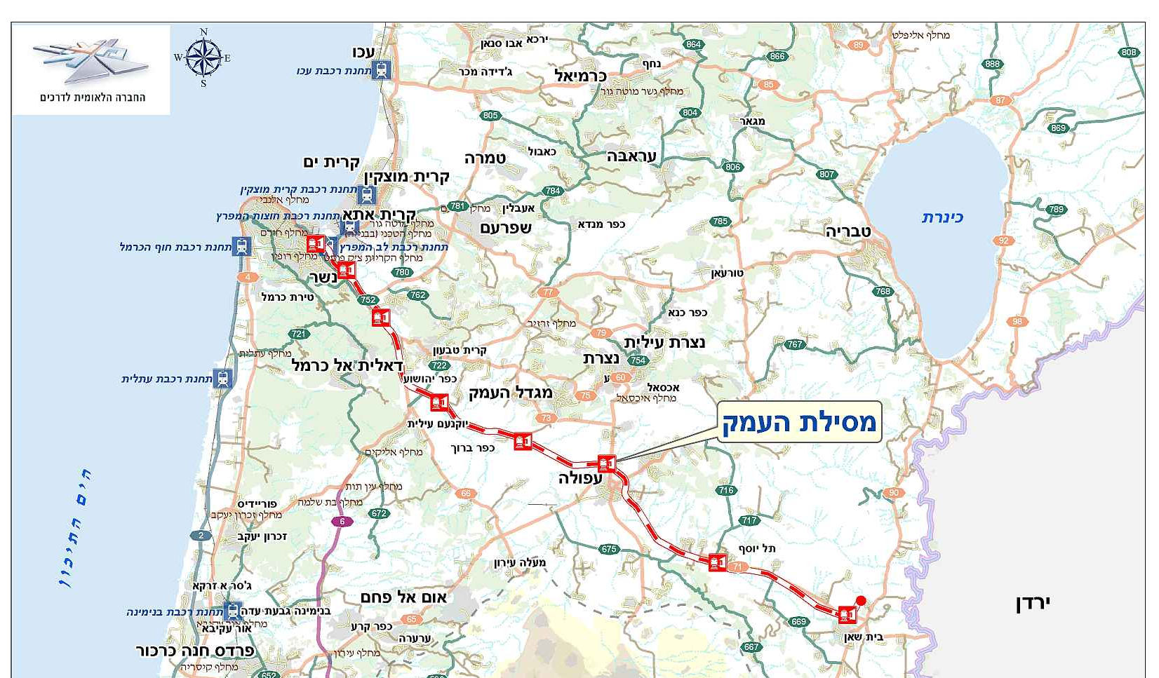
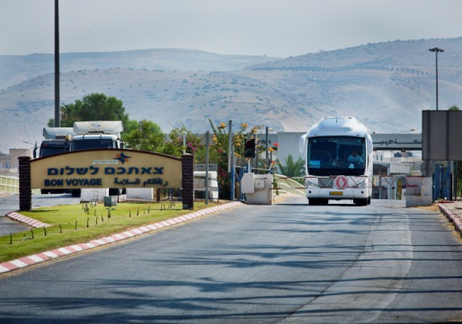
Yokneam is a Gateway
Yokneam Railway Station
Haifa Port
Jordan Border

Slide 7
Expandable to Grow and Stay
Gateway = Affordable Space and Employee Base
Equivalent Space
$15-20/sq.m in Yokneam
$30-$40 in Central Israel
more for a prime location
Wide Area = Affordable Human Resources

Slide 8
Expandable to Grow and Stay
Mellanox
1999 moved to Yokneam with 150 employees
Currently 1,000+ in Yokneam
Syneron
2000 company was founded
Currently employs hundreds in Yokneam
Given Imaging
1998 founded by Dr. Gabi Iddan and Dr. Gavriel Meron
Now part of Medtronic and employs 323 in Yokneam
Annapurna
2015 Amazon acquired Annapurna Labs startup
Currently growing rapidly in Yokneam

Slide 9

Funding is External, but Accessible
Government Incentives
Technology incubators
Banks
VCs and Angels

Slide 10
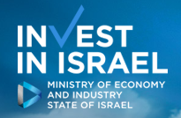

Government Incentives
20% investment grant*
+
Tax incentives
+
Priority for Innovation Authority funding
(Office of Chief Scientist)

Slide 11
Technology incubators
Terralab Ventures
Explore- Dream-Discover
Alon MedTech
Youdim Laboratories

Slide 12
Banks and VCs
Largest Bank - Special High-Tech Investments Division
Local branches of other banks
VCs and Angels already invest in Yokneam

Slide 13
What Brings Young Professionals
Technion and Haifa University
Outdoor living
Alternative lifestyles – small community for almost anything
Ideology

Slide 14
What Makes them Stay
Interesting jobs
Good schools and after-school opportunities
Better housing at ½ price
Lower property taxes and CoL

Slide 15
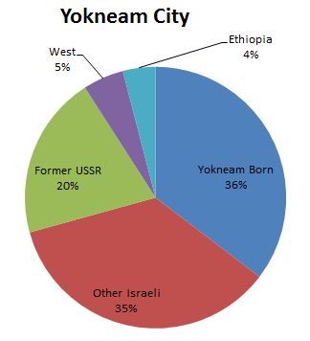
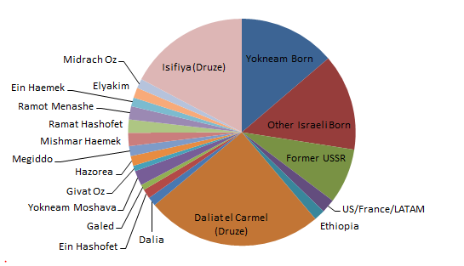
Human Resources from a Wide Area
Local Demographics – Cosmopolitan Mix
Yokneam – 20-25,000
Kibbutz and Moshav - 12,000
Druze Villages – 28,000 (serve in the IDF)

Slide 16
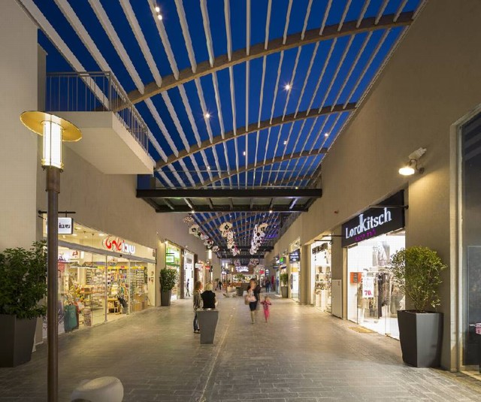
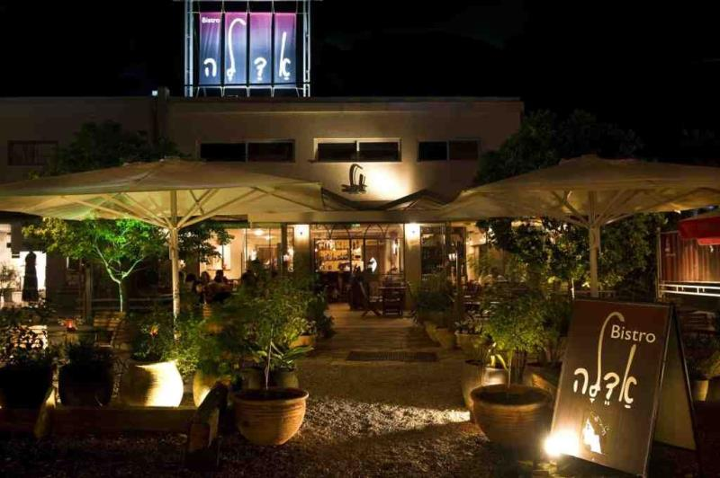

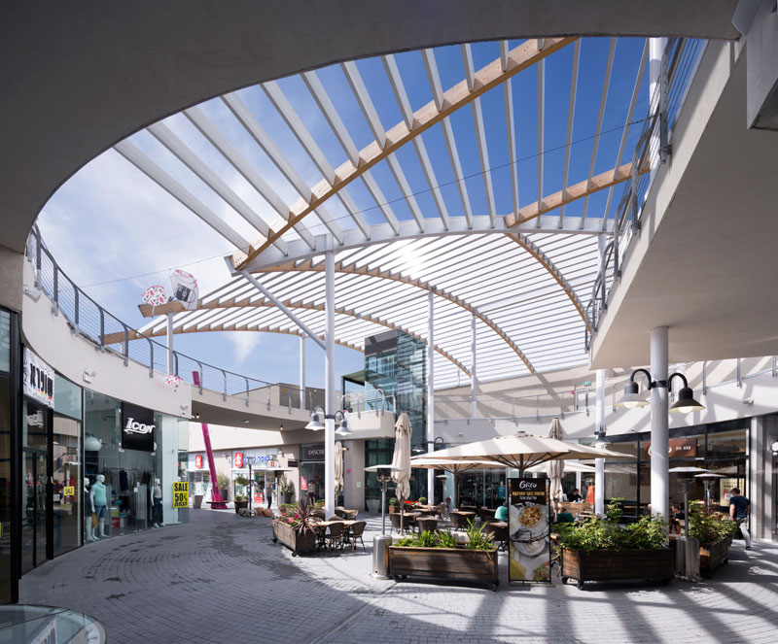
Restaurants & Nightlife
Ramat Ishai

Slide 17
City Leadership Cuts Bureaucracy
Past
Mayor personally intervened to cut bureaucracy
Present
Well run city eliminates most problems
Mayor personally intervenes when necessary

Slide 18
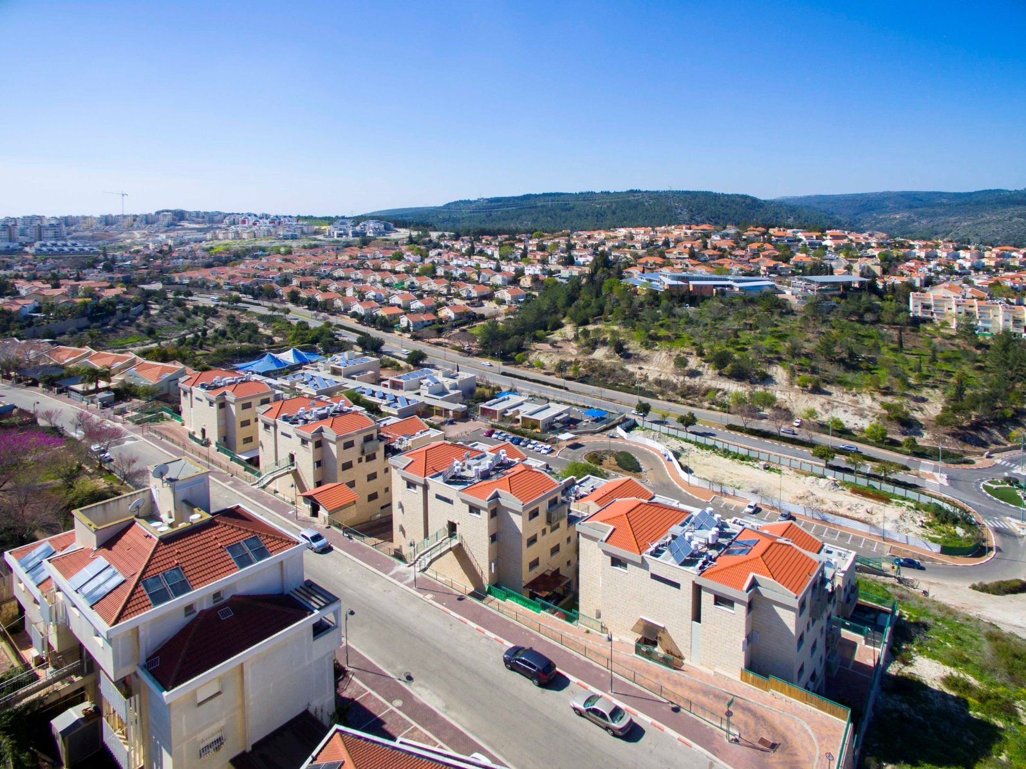
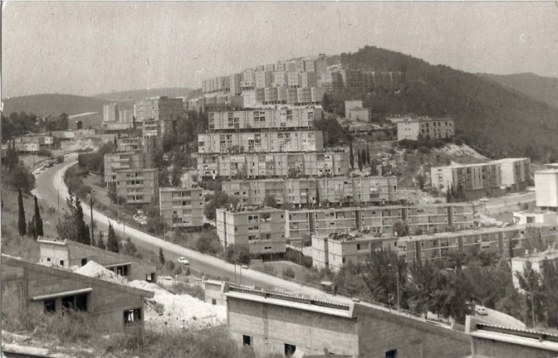
Yokneam Changed
1980s
Now

Slide 19
Three Elements of Change
Crisis
Local Leadership
Long-term planning and investment

Slide 20
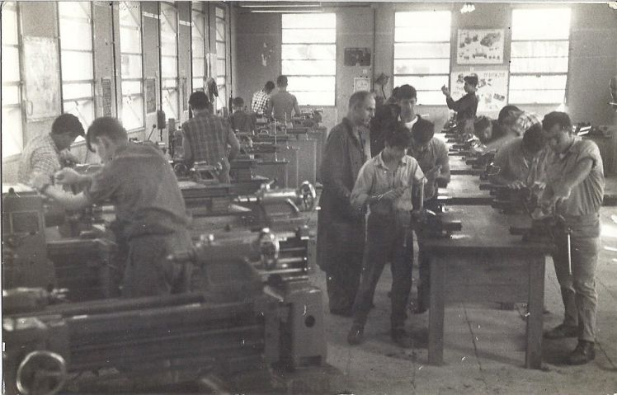
Crisis
Massive Layoffs
35% Unemployment

Slide 21
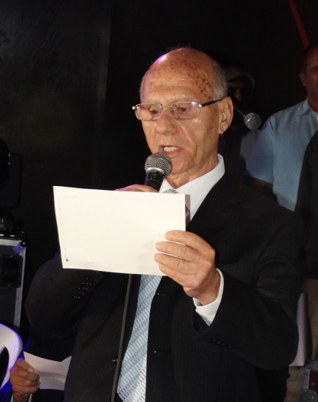
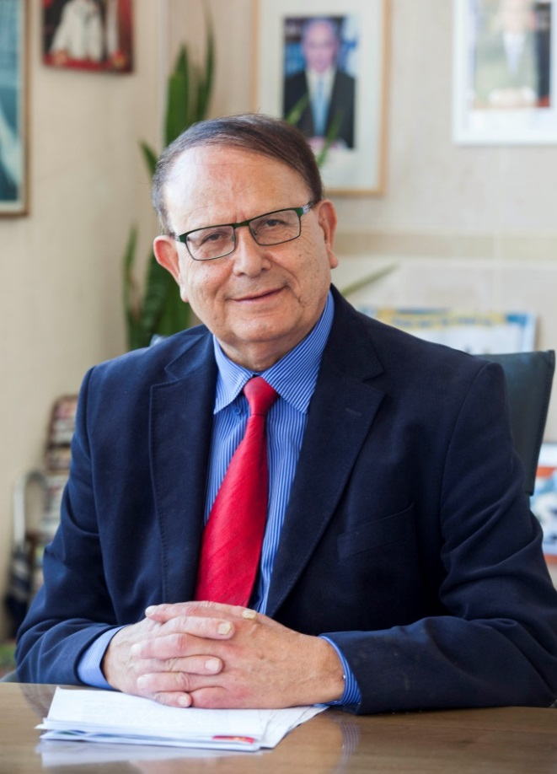
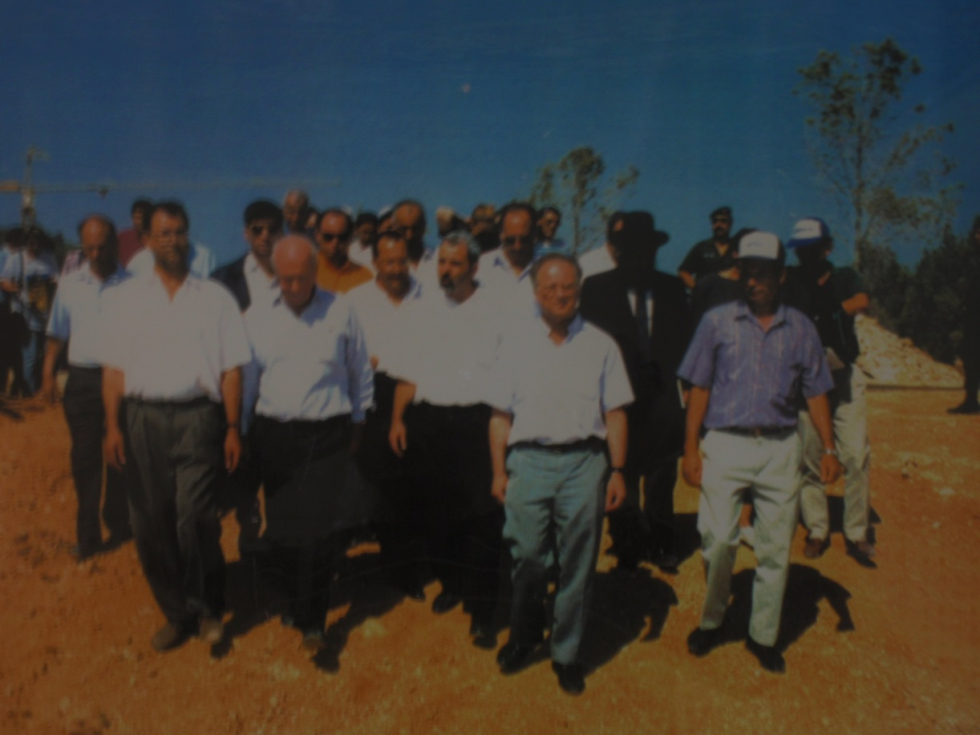
Local Leadership
Convincing national leadership of a new strategy
Simon Alfassi - Mayor
Working visit with PM and ministers
Infrastructure
  Cut bureaucracy

Slide 22
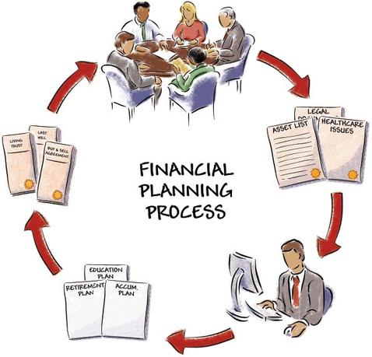




Long-term planning and investment

Slide 23
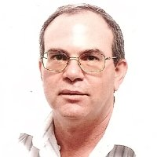
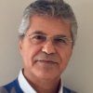
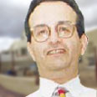
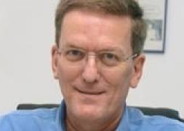
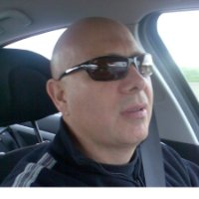
Early Beginnings
1985 – Adacom
1990 – Crisis at Soltam
2700 Employees
35% Unemployment

Slide 24
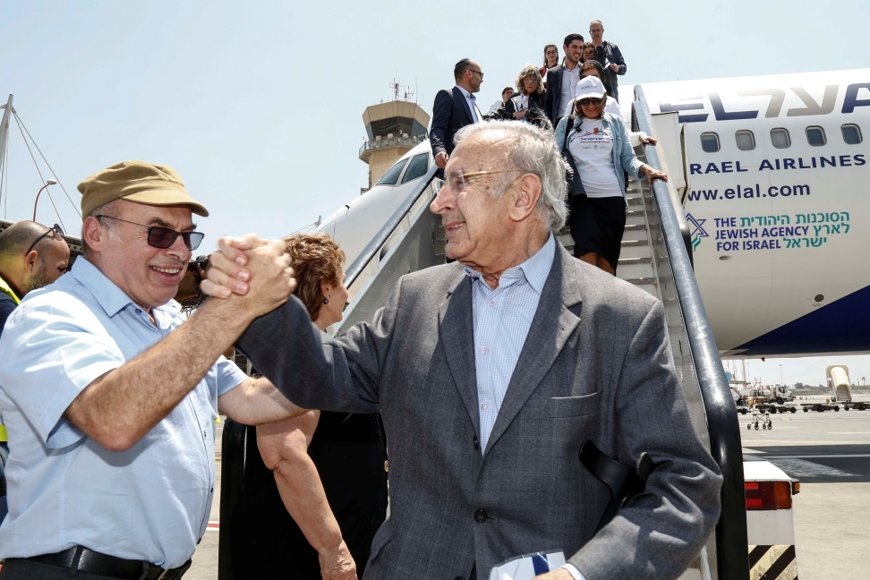
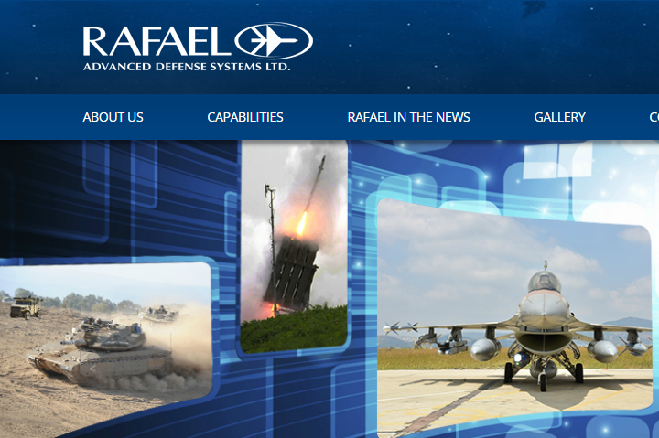
Other Catalysts
Immigration from USSR
Major Layoffs at Rafael

Slide 25
Initial Pool of Technology HR
1- City recruits employees with needed skills
Residents
New Immigrants
Nonresidents willing to move to Yokneam

Slide 26
Initial Pool of Technology HR
2 - Atheza for immigrants from USSR
All management and employees - immigrants
Subcontractor for electronics manufacturers
Underemployed but still in technology

Slide 27
Transportation Infrastructure
Route 70 - Yokneam is main artery to north of Haifa
1992 – Gov’t decides to build Route 6 with Yokneam as the Gateway to the North
2009 – Yokneam is main TLV-North artery and Jerusalem – Haifa – North artery
2017 – Northern railway opens
2019 – Complete 2nd Yokneam Intersection

Slide 28
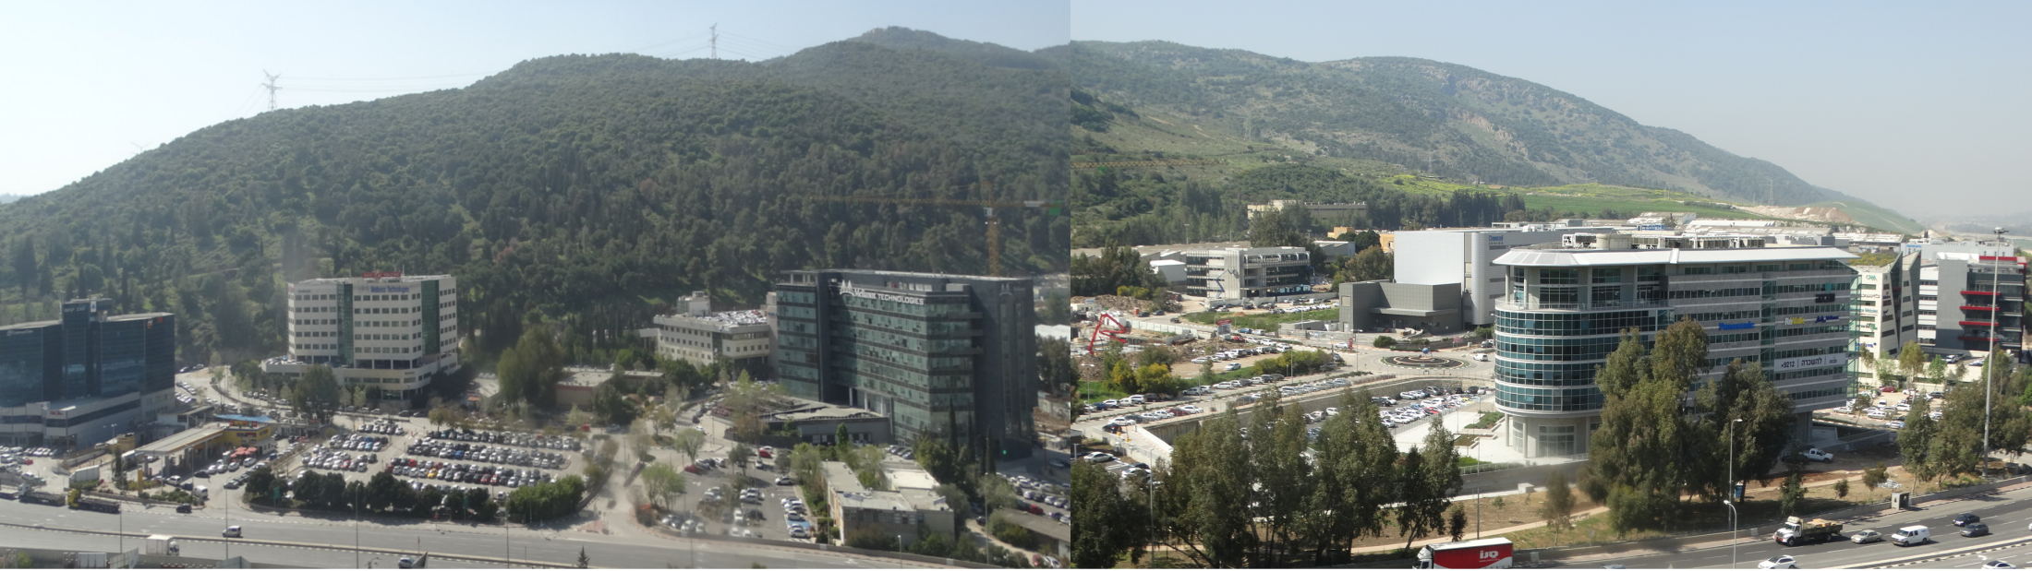
Summary
Started with: Crisis + Leadership + Planning
Yokneam is a Gateway
30 Years of Constant Growth
Will Continue to Grow

Slide 29
Specific Contact Requests
Visuality –interested in:
Medical companies
Avio who makes electronic/electrical control and automation systems.
Telespazio - a French-Italian company who operates in the space market
Contact info: Tal Widerman, Marketing Manager at talw@visualitynq.com
Synel –interested in finding Italian distributors.
Should be a SW company with:
ability to enter customer definitions into the SW and provide technical tech support
experience in the field of CRM and/or ERP
has both sales personnel and technical personnel
Contact info: Erez Buganim at erez@synel.com

Slide 30
Specific Contact Requests
FibroLAN –interested in:
Telecom companies
System integrators
Contact info: Israel Stein, Director at stein@fibrolan.com
SixGill –interested in:
Large organizations such as banks, insurance, law enforcement or intelligence that need to monitor and analyze the Dark Web
Strategic partners that would incorporate the SixGill solution into theirs, such as MSSPs - (managed security service providers)
Investors
Contact Info: Barry Spielman, VP Marketing at barry@cybersixgill.com

Slide 31
Specific Contact Requests
Sela –interested in:
research centers and universities which investigate in semiconductors
Contact Info: Vladimir Zheleznyak at vladimirz@sela.com
Onvego –interested in:
Investors
Strategic partners in telecom or other industries where people’s hands are not free to make selections on a machine
Contact Info: Mark Heifets at markh@onvego.com

Slide 32
More Information
www.StartupVillageYokneam.org
yosim@yoqneam.org.il (Yokneam City Manager )
Tzvi@StartupVillageIsrael.org
www.investinisrael.gov.il
(Investment Promotion Center)

